Slide 1
Mini Project Team 1
1. Abhishek Dengi:01FE20BAR046
2. Nakul Sharathkumar: 01FE20BAR027
3. Nitin Mahadev Ghorpade: 01FE20BAR038
4. Patanjali Joshi: 01FE20BAR036
5. Samarth Vengurlekar: 01FE20BAR006
Department Of Automation and Robotics, 2022-2023

Slide 2
The Problem
Automated Domestic Irrigation System
Automated Domestic Irrigation System
Inconvenience: Watering plants manually can be time-consuming and inconvenient, particularly for people who are busy or away from home frequently.
Water waste:
Manually watering plants can sometimes result in water waste due to overspray or runoff.
Inconsistent watering: It can be difficult to maintain a consistent watering schedule manually, which can lead to over or under watering of plants
Plant health: Inconsistent watering or over/under watering can lead to poor plant health.
Notes:
Inconvenience-time consuming and Hard to schedule into busy urban lifestyle
Inconsistent watering-difficult to manually schedule,over or under watering
Wastage-Manually watering=more wastage
Plant health- Inconsistency=poor plant health

Slide 3

Automated Domestic Irrigation System
Our Solution
Automated Domestic Irrigation System
A fail-proof, easy to operate and resource-efficient solution to regulate the soil moisture level of the garden and maintain the general health of plants.

Slide 4
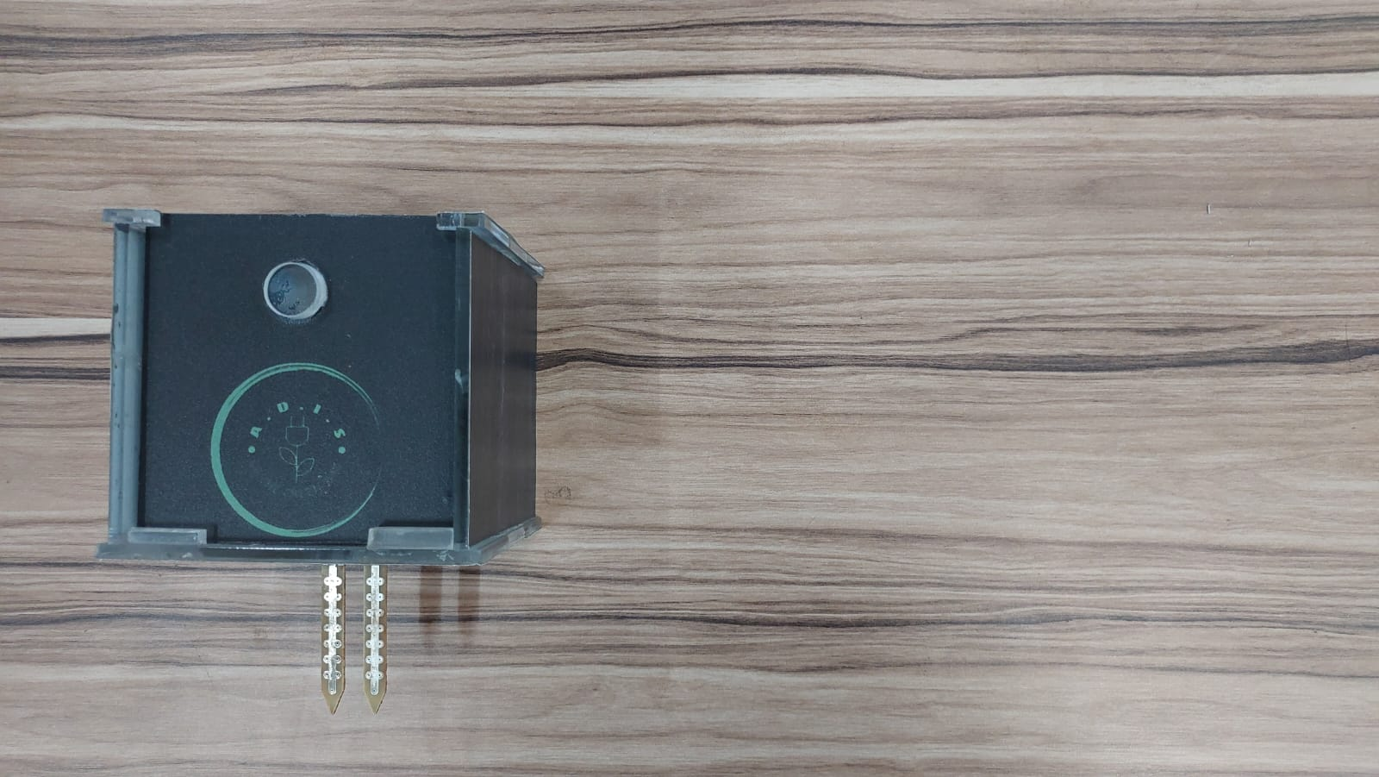
How Does It Work??
Sensor Unit:
The sensor unit measures the real-time soil moisture level and updates it in the database.
Notes:
Sensor unit
components used:
sensor passes current through soil and measures resistance
esp8266 - 70 mA per hour
Batteries
switch
Explain the working

Slide 5


How Does It Work??
Web Interface:
Displays the current soil moisture level and valve status to the user.
Notes:
000web host is used to host the website
PHPMyadmin is used to create the database
This is used to display the sensor value and valve status

Slide 6
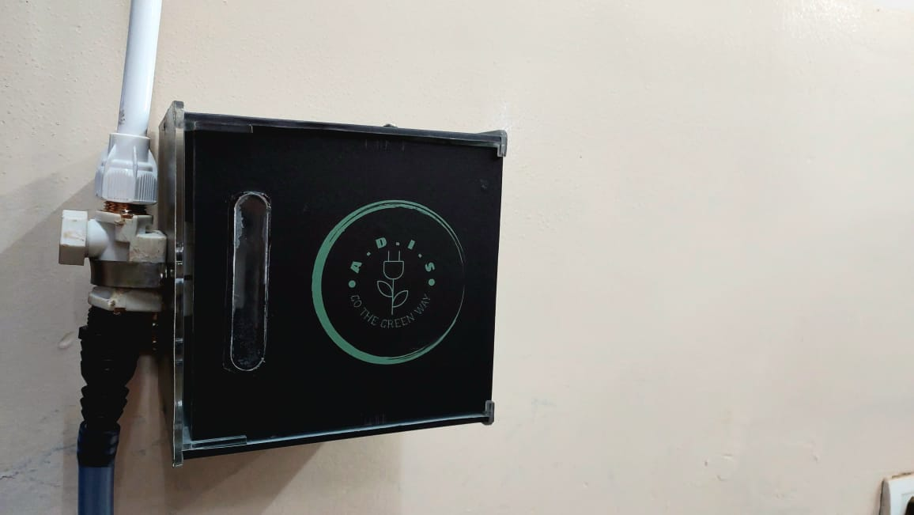
How Does It Work??
Control Unit:
The control unit receives moisture data from the database and actuates the valve accordingly.

Slide 7
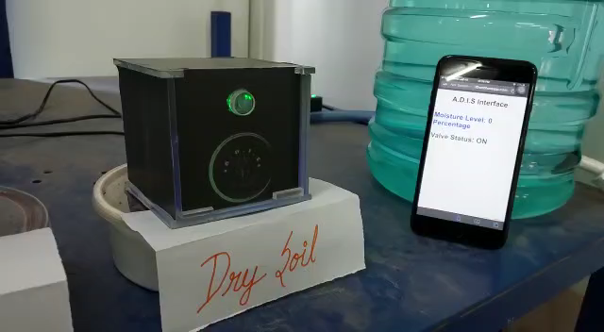
How Does It Work??
Demonstration of working prototype

Slide 8
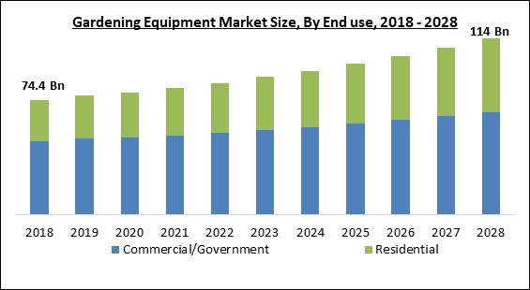
Market Analysis
Global Gardening Equipment Market size
$74.4 $114 5.0%
billion by 2018 billion by 2028 Expected CAGR
Indian Gardening Home Retail Sector Market size
₹ 3,538 ₹ 5,807 10.4%
billion in 2020 billion by 2025 Expected CAGR
Source:
Home and Garden Retailing in India - Sector Overview, Market Size and Forecast to 2025 (researchandmarkets.com)
Global Gardening Equipment Market Size, Share & Industry Trends Analysis Report By End use (Commercial/Government and Residential), By Product, By Sales Channel, By Regional Outlook and Forecast, 2022-2028 (researchandmarkets.com)
Notes:
Now, I’d like to evaluate the market and judge the feasibility of our product.

Slide 9
Price Estimation
₹ 2318*
Material Cost
₹ 600
Labor Cost
₹ 200 Overhead Cost
₹ 3118
Total Manufacturing Cost
44%
Profit Margin
₹ 4499 Selling Price
~₹ 1381
Profit Gain
*Refer Bill of Materials from Project Report
Notes:
Direct material cost incurred, labour cost->estimation, overhead-> miscellaneous expenses like electricity water etc
With a profit margin of 44, well be standing to get about 1300-1400 rs in profit gain thus bringing our final selling price to 4499

Slide 10
Conclusion
The domestic irrigation system will improve the efficiency of watering the garden and reduce water usage. The system would consist of a network of sprinklers or drip lines, controlled by the central control unit, to efficiently distribute water to plants and lawns. The sensor-based irrigation system will also reduce the amount of time and effort required in maintaining the garden. Overall, the domestic irrigation system project would help improve the sustainability and aesthetic of the community.
Notes:
The efficiency of the irrigation
the central unit distributes water to the garden
sensor-based irrigation eliminates need for manual intervention

